Slide 1
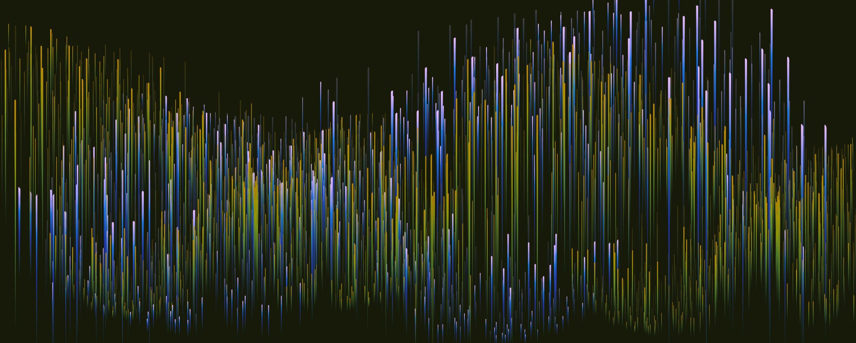
N2YO.COM BASICS

Slide 2
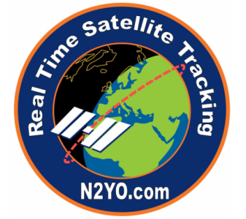
WHAT IS N2YO.COM ?
N2YO.com is a free to use online website which provides real time tracking and pass predictions with orbital paths and footprints overlaid on Google Maps
This website is immensely popular among radio hobbyists and communication engineers who want to test their equipment
It provides accurate information and is quite famous for providing the location of ISS (International Space Station)

Slide 3
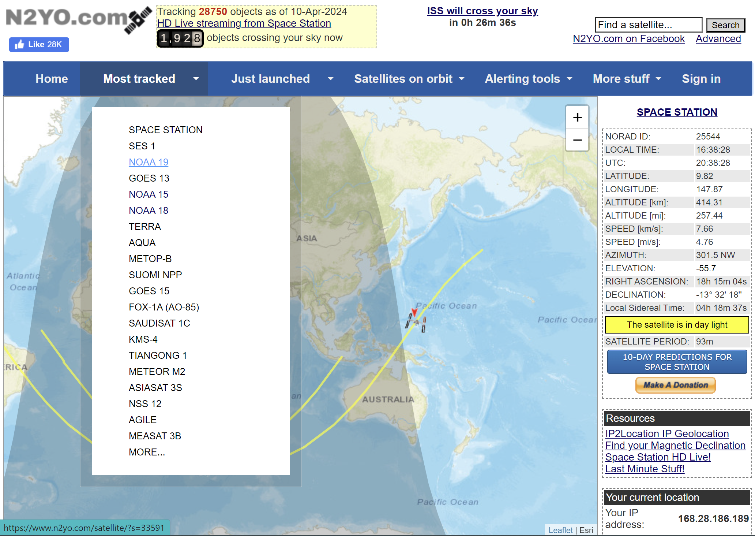
Learning how to use N2YO
The website provides a lot of satellites to work on, as discussed previously, we will focus on NOAA series
Select NOAA 19 from the “Most tracked” menu, it will take you to a new page

Slide 4
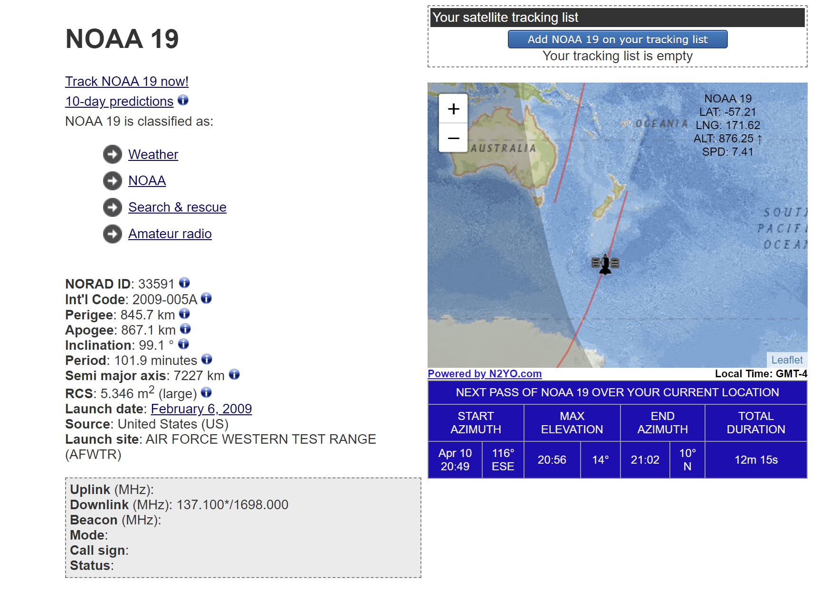
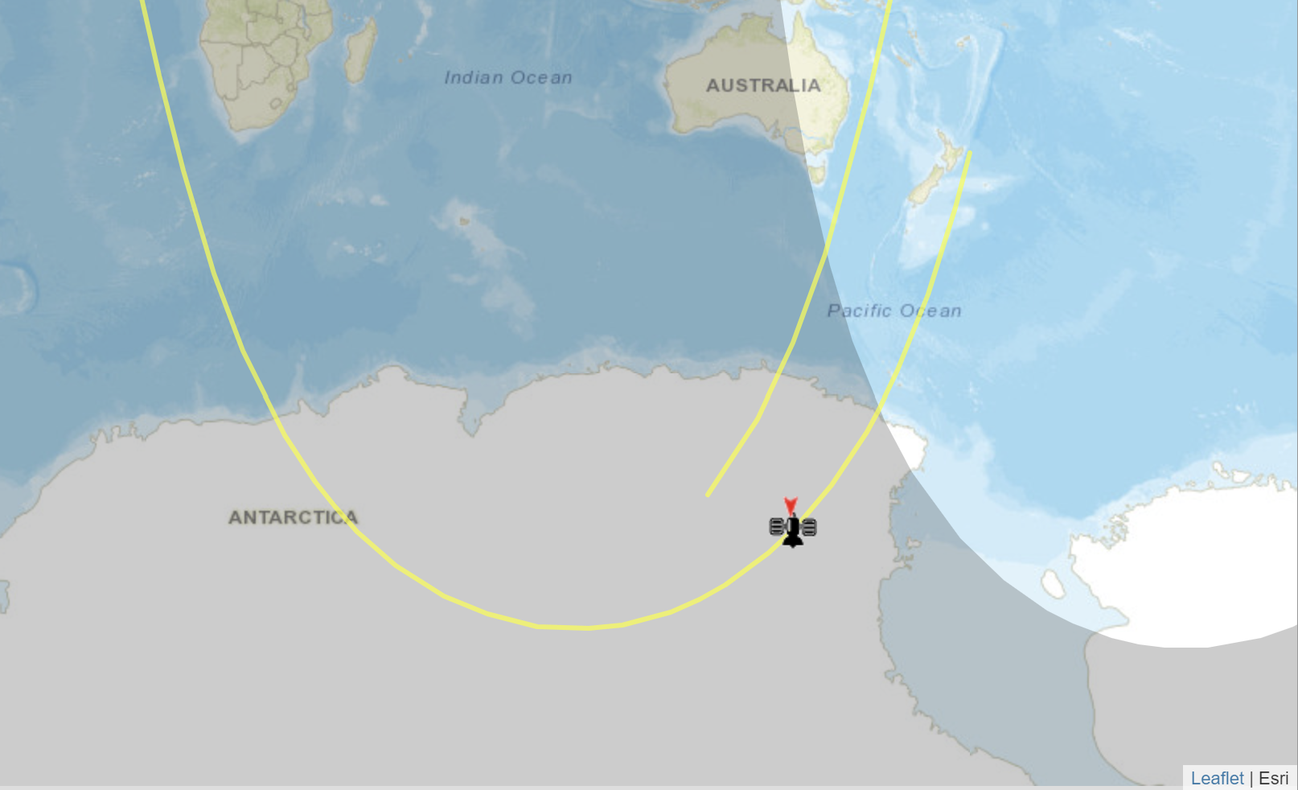
The new page will provide some basic information of the satellite.
Track NOAA 19 now! And 10-day predictions links are of our interest in this project.
Click on Track NOAA 19 now ! Link
The new page provides a dynamic 2D image which shows that the satellite is passing over Antarctica. (It was near New Zealand just few minutes ago ! These things are fast ! )

Slide 5
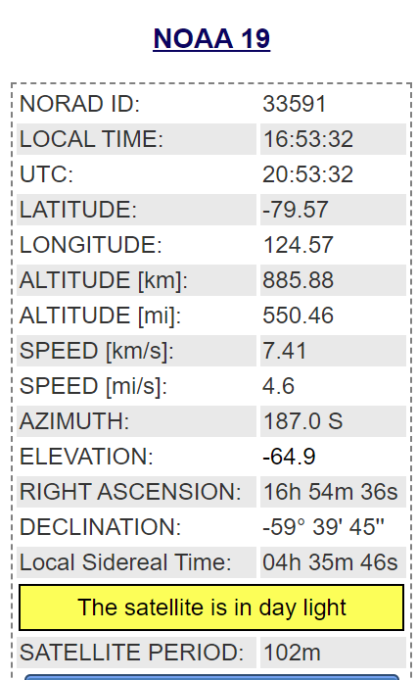
The webpage also provides info regarding the various parameters of the satellite.
The Satellite Catalog Number (SATCAT, also known as NORAD (North American Aerospace Defense) Catalog Number, NORAD ID, USSPACECOM object number or simply catalog number, among similar variants) is a sequential nine-digit number assigned by the United States Space Command (USSPACECOM) in the order of launch or discovery to all artificial objects in the orbits of Earth and those that left Earth's orbit.(source:Wikipidea)
As the earth is in the shape of a sphere, the location point, directly beneath the satellite is represented in the form of Longitude and Latitude

Slide 6
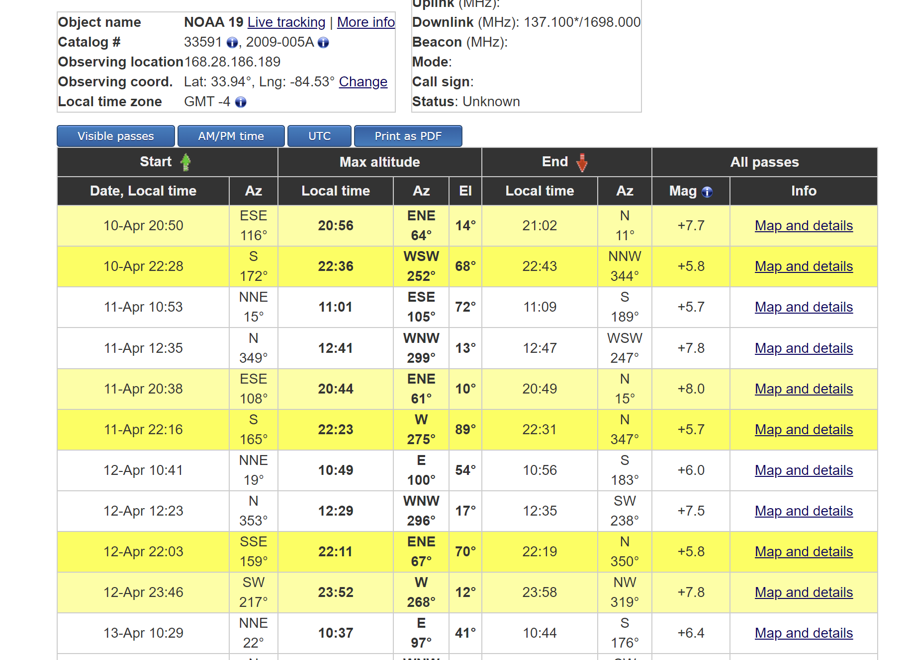
Now go to the previous page and click on 10-day predictions link
It provides a detailed schedule of satellite passes. As of 10th April, we had 2 passes at 8:56 PM and 10:36 PM. We can convert the 24-hour format to standard 12-hour format by subtracting 12 from the former.
The schedule also provides the end of a given satellite pass.
Hence the SDR user must setup his equipment in advance and record the audio signal coming from the satellite before the satellite passes away.

